Slide 1

Sales Forecasting Across Multiple Retail Stores
By Latha Payani

Slide 2
Understanding Key Features
The provided dataset offers a comprehensive view of Rossmann's store operations, Key features included.
Id: Unique identifier for each (Store, Date) pair.
Store: Unique ID for each retail store.
Sales: Daily turnover – our primary prediction target.
Customers: Daily customer count.
Open: Store open/closed indicator (0 = closed, 1 = open).
StateHoliday: 'a' (public), 'b' (Easter), 'c' (Christmas), '0' (None).
SchoolHoliday: Indicates public school closures affecting the store.
StoreType: Differentiates 4 store models (a, b, c, d).
Assortment: Describes assortment level (a = basic, b = extra, c = extended).
CompetitionDistance: Distance to the nearest competitor in meters
CompetitionOpenSince: Approximate year/month of competitor's opening.
Promo: Indicates if a store is running a daily promotion.
Promo2: Ongoing consecutive promotion (0 = no, 1 = participating).
Promo2Since: Year/week when Promo2 participation began.
PromoInterval: Months when Promo2 starts (e.g., "Feb,May,Aug,Nov").

Slide 3
Project Description and Objectives
Task 1 - Exploration of customer purchasing behavior
This task involves analyzing historical transaction data to uncover patterns and trends in customer buying habits. Insights such as popular products, peak shopping times, and customer segmentation help in understanding consumer preferences and improving marketing strategies.
Task 2 - Prediction of store sales
In this task, machine learning models are developed to forecast future sales based on historical data, seasonal trends, promotions, and other influencing factors. Accurate sales predictions support inventory management, staffing, and revenue planning.
Task 3 - Serving predictions on a web interface
This task focuses on deploying the sales prediction model to a user-friendly web application. The interface allows stakeholders to input relevant parameters and receive real-time sales forecasts, making the model accessible and actionable for business decision-makers.

Slide 4
Exploratory Data Analysis Techniques
Data Summary Missing Values Outlier Detection Visualizations Summarize key statistics Identify and assess the Detect and analyze Create visualizations
such as mean and extent of missing values outliers to understand to compare sales
median values. in the dataset. their impact. across various conditions.
Correlation Analysis Trend Analysis Group Comparisons Feature
Examine relationships Identify and explore Compare sales Analyze which
between sales and other seasonal trends in performance across features have the
features. customer behavior. different store types. most influence on sales.

Slide 5
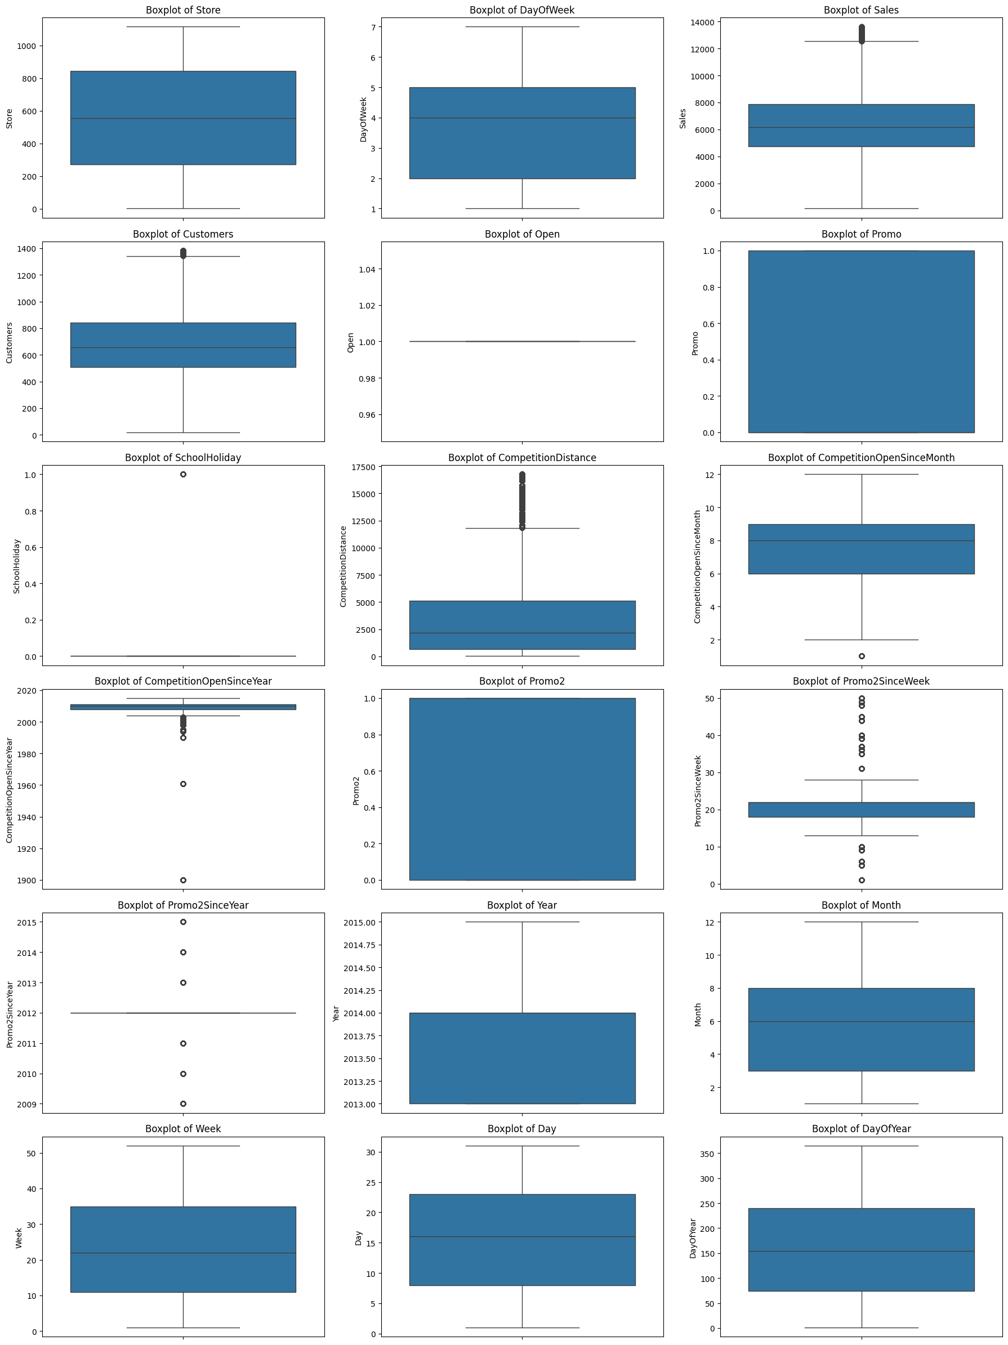
Exploratory Data Analysis Visualization

Slide 6
Customer Purchasing Behaviour
Seasonal Patterns
Identify seasonal purchasing patterns for better inventory management.
Analyze Trends
Determine trends by analyzing sales data across various store locations.
Promotional Impact
Evaluate the effects of promotions on sales and customer visit frequency.
Competitor Influence
Assess how proximity to competitors affects daily sales figures.

Slide 7
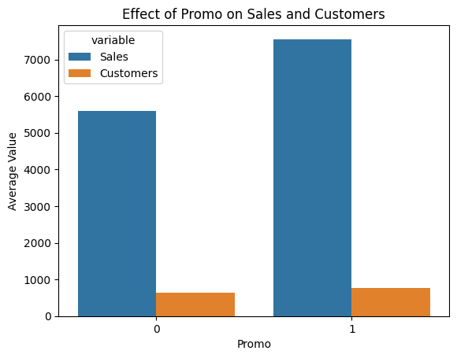
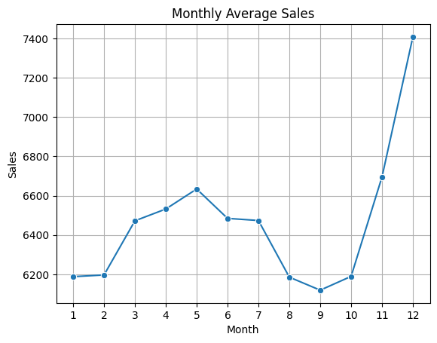
Exploration of customer purchasing behavior some Visualization

Slide 8
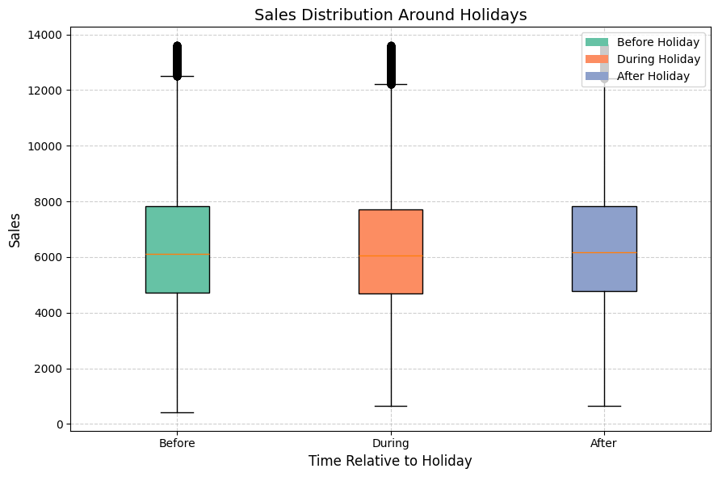
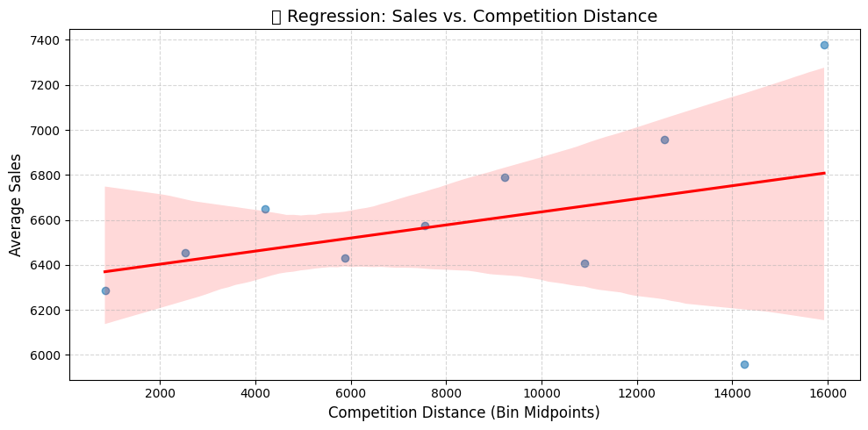

Slide 9
Prediction of store sales
Feature Importance Identify key factors influencing sales using model analysis techniques.
Cross-Validation Ensure model robustness by implementing k-fold cross-validation strategies.
Error Analysis Evaluate and analyze prediction errors to refine model accuracy and robustness.
Ensemble Methods Combine multiple tree models for improved robustness and predictive accuracy.
Deployment Ready Prepare the model for production deployment, ensuring it serves predictions efficiently.
Model Evaluation Assess performance against predetermined accuracy metrics.
Hyper-parameter Tuning Optimize model performance via techniques like Grid Search and Random Search.
Confidence Intervals Calculate the range within which predictions likely fall.
Bias Adjustment Modify the model to correct for systematic biases.
Re-training Re-train the model with new data for improved accuracy.

Slide 10
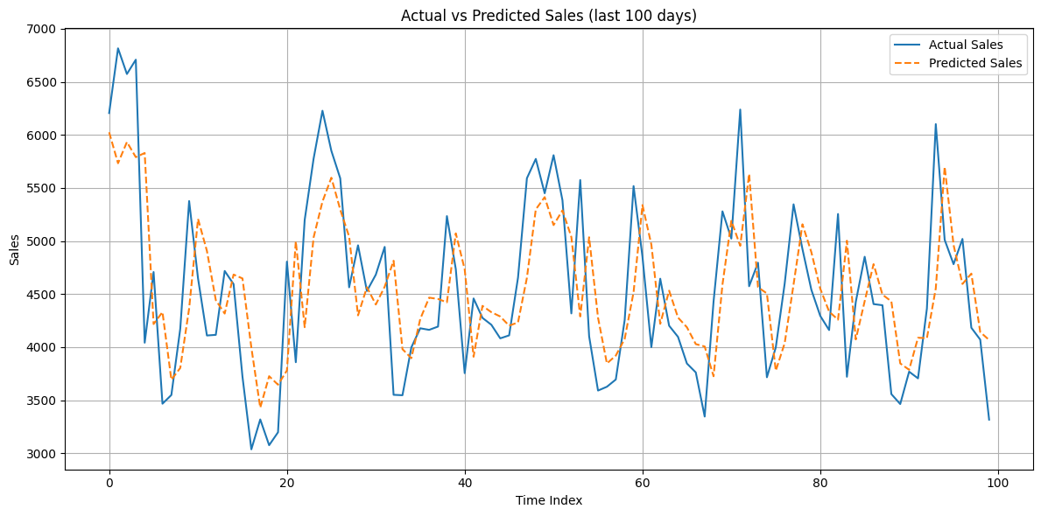
Deep Learning Approaches: LSTM Overview
Isolate Time Series Data Extract Rossmann sales as time series, ensuring proper temporal ordering
Stationarity & Differencing Check for stationarity and apply differencing if needed to stabilize the mean and variance
Autocorrelation Analysis Examine autocorrelation and partial autocorrelation to identify hidden dependencies.
LSTM Model Building Construct a two-layer Long Short-Term Memory (LSTM) Recurrent Neural Network using TensorFlow
Prediction Confidence Use confidence intervals around predictions to assess the reliability of outputs.

Slide 11
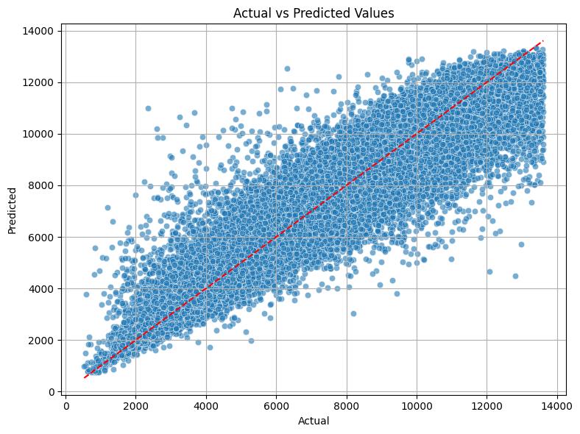
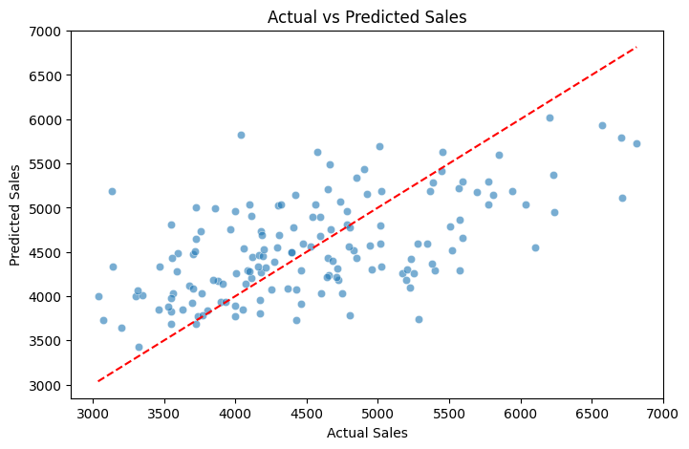

Slide 12
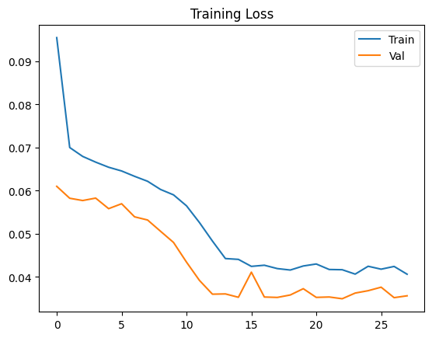
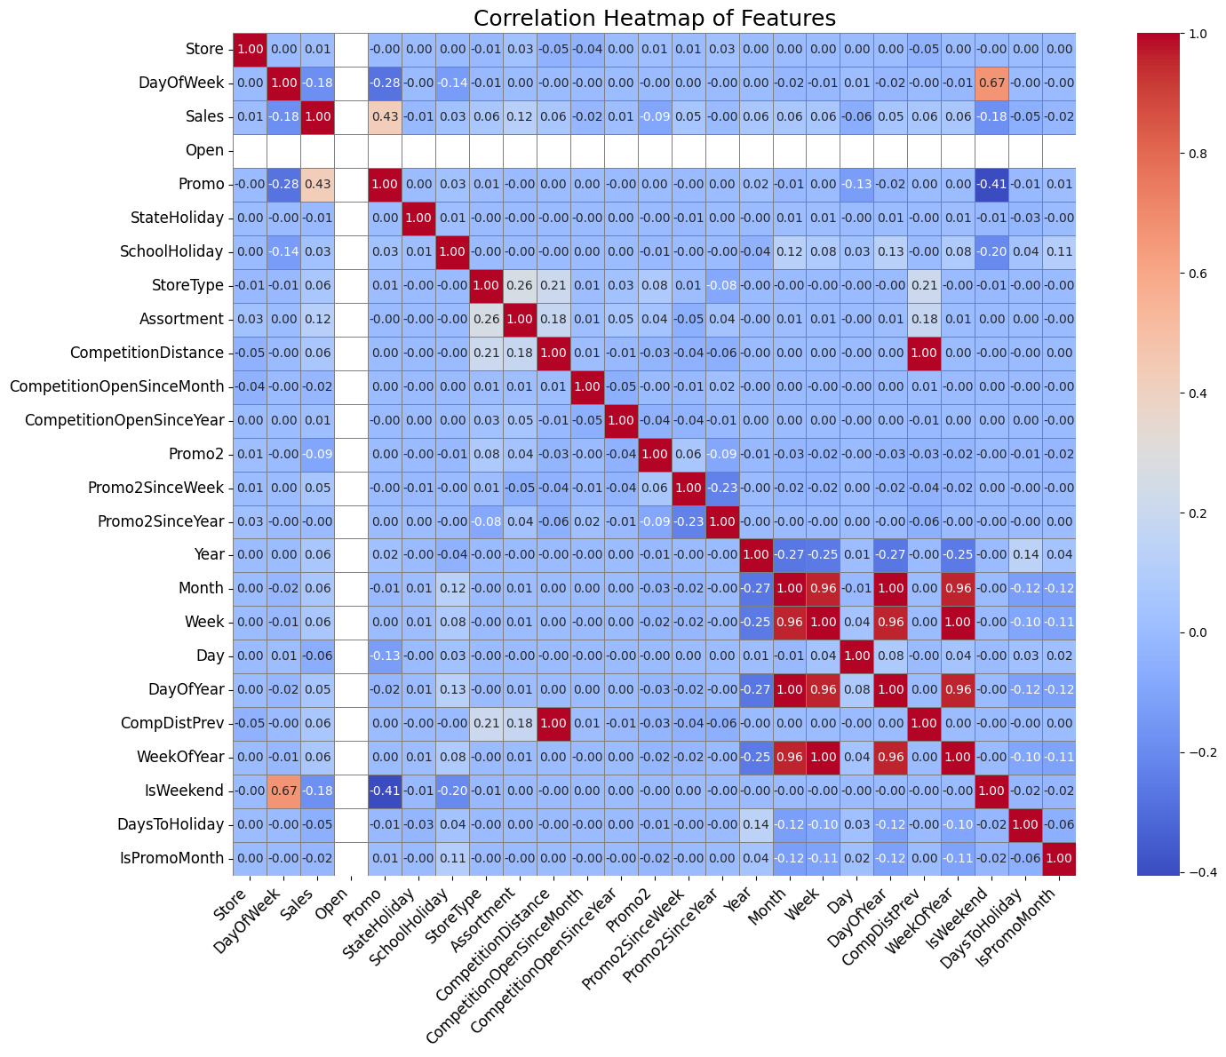

Slide 13
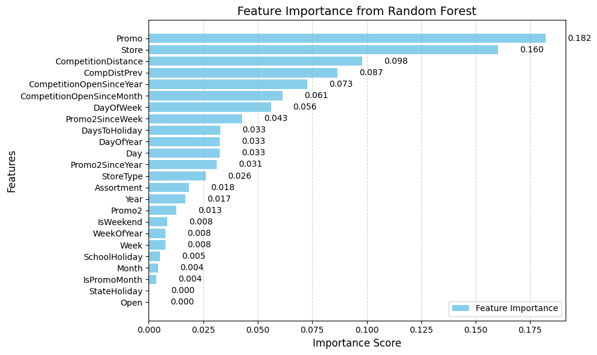

Slide 14
Accurate Sales Predictions
Implementing a model enhances accuracy in sales forecasting across stores.
Data-Driven Insights Utilizing data reveals important trends and influences on purchasing behavior.
Promotions Matter Active promotions significantly impact sales performance throughout the analysis.
Customer Behavior Insights Understanding customer flow is crucial to predicting daily sales effectively.
Technology Utilization Leveraging advanced algorithms improves forecasting efficiency and accuracy.
Web Interface Convenience A user-friendly application facilitates easy access to sales predictions for managers.
Final Thoughts
and Conclusion

Slide 15
Thank you

